Slide 1
MINERAL RESOURCES OF PAKISTAN

Slide 2
WHAT ARE MINERAL RESOURCES?
Minerals are inorganic substance made by nature
These are resources of utmost significance found and extracted from the surface of the earth
They can be classified into Metallic and Non-Metallic minerals

Slide 3
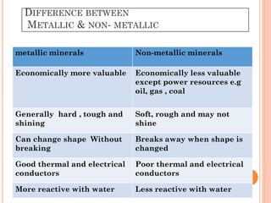
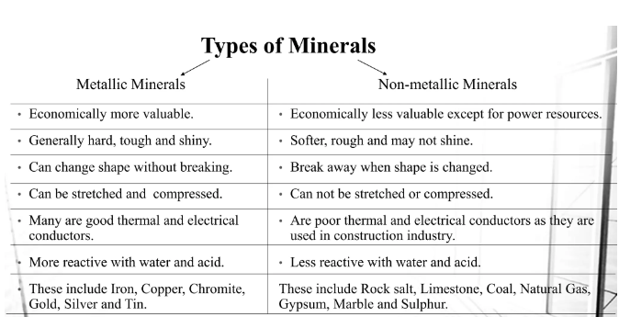
WHAT ARE MINERAL RESOURCES?
Minerals are inorganic substance made by nature
These are resources of utmost significance found and extracted from the surface of the earth
They can be classified into Metallic and Non-Metallic minerals

Slide 4
Pakistan is endowed with great geological potential.
It is blesssed with huge reserves of minerals covering an area of almost 600,000 sq. Kms
There are 92 known minerals of which 52 are commercially exploited
The most potential and valuable minerals of Pakistan include; Marble, Granite, Coal, Chromite, Gypsum, Copper, Gold, Iron Ore, Lead zinc, Bauxite, Crude oil and Natural gas.

Slide 5
COAL
Pakistan has world’s 5th largest coal reserves
The total coal resources in pakistan, estimated by the Geological Survey of Pakistan(GSP) are reported to be approximately 185 billion tonnes.
Tharparkar division of Sindh is said to host huge deposits of coal
Besides Sindh, large coal reserves are also found in Balochistan (Dukki, Quetta, Harnai, Ziarat) and Punjab(The Salt Range Coal Mine)

Slide 6
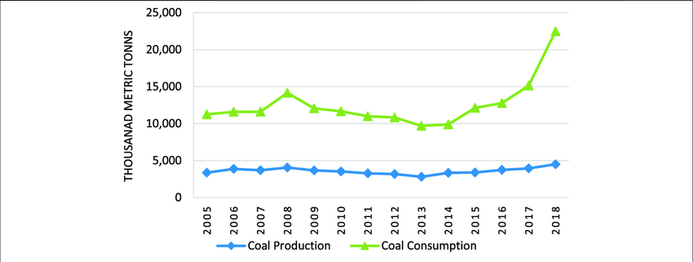

Slide 7
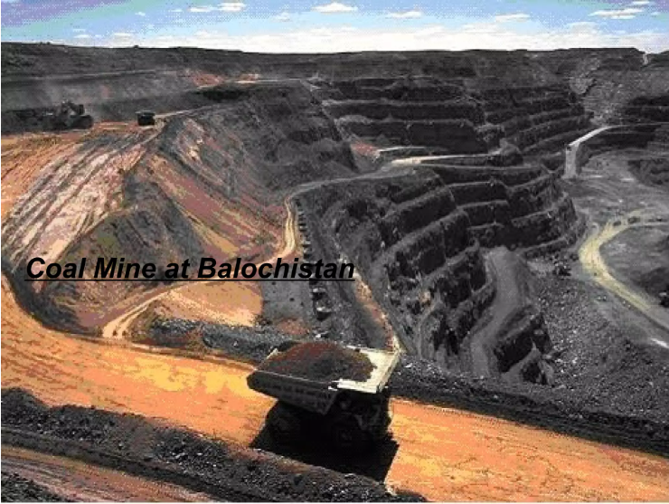
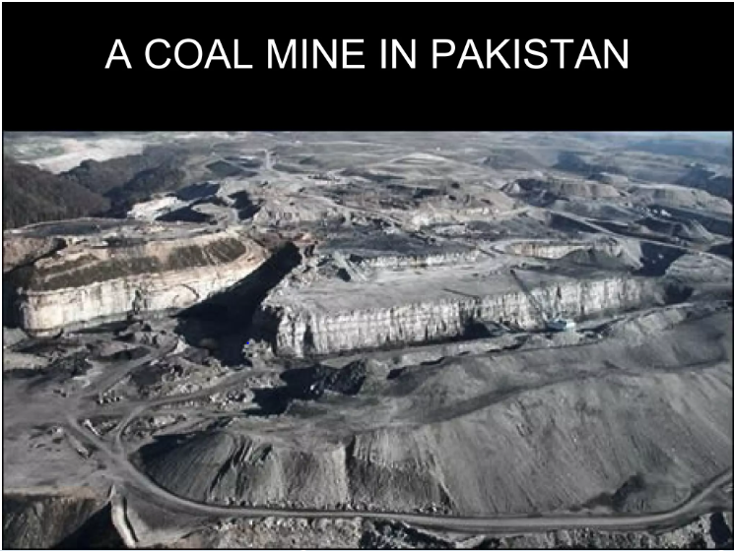

Slide 8
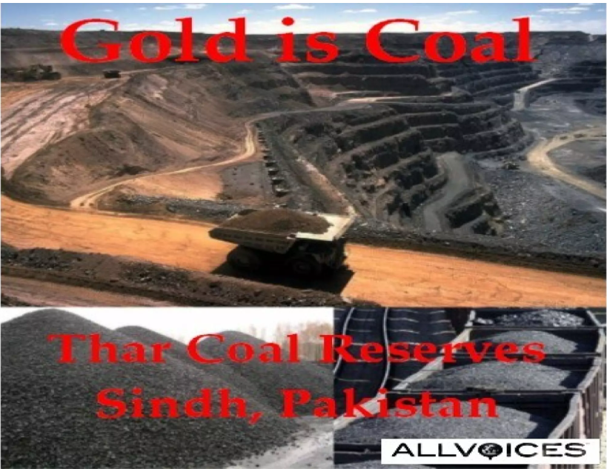

Slide 9
COPPER AND GOLD
Copper and Gold reserves in Pakistan and are mainly found in Balochistan
A small town of Balochistan, Reqo Dik, tends to contain the main deposits of copper
It is also the 5th largest gold mine in the world with more than 54 million tons of Gold

Slide 10
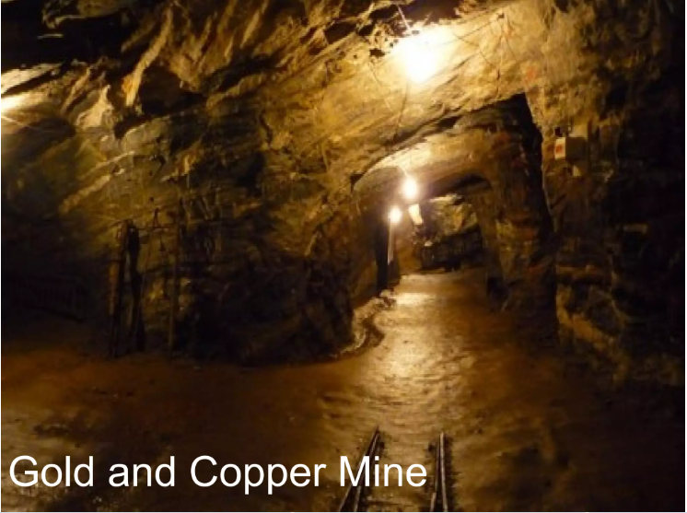

Slide 11
NATURAL GAS
This mineral resource is of extreme significance as more than 90% of the country's energy needs are met by gas
The SUI gas field, located near sui in balochistan is the biggest natural gas field in Pakistan
Besides balochistan , Qadirpur,located in Sindh, ranks as the second largest gas field in Pakistan after Sui, with original recoverable reserves of about 4 trillion cubic feet .
A recent study suggests that Pakistan has around 19 trillion cubic feet (Tcf) of proven gas reserves
Punjab supplies just 4% of gas while it consumes 43%...????

Slide 12
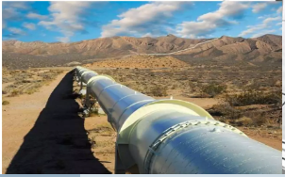
A SUI GAS PIPELINE IN BALOCHISTAN

Slide 13
Iron Ore
Iron ore is among the top five minerals found in Pakistan
Iron ore is found in various regions of Pakistan including Nokundi, Chiniot, Kalabagh the largest one, Haripur and other northern areas.
Today almost all (98%) iron ore is used in steelmaking.

Slide 14
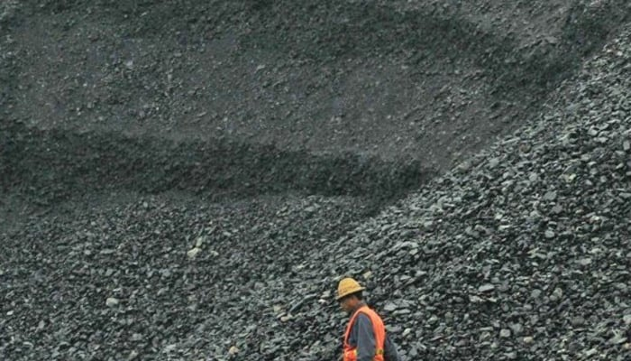
Iron ore reserves in chiniot

Slide 15
CHROMITE
In Pakistan Chromite Deposits are located in Chilas, Shangle-Mingora, Malakand, Sakhakot (Dargai), Waziristan, Zhob valley, Bela and Muslimbagh.
Majorly found in Balochistan province, Pakistan.
The chromite mineral has economic significance in nichrome, paint industry and stainless steel.

Slide 16
LIMESTONE
In Punjab, deposits are found in the cracks of limestone in the form of veins. It is found in Attock, Rawalpindi, Chakwal, Jhelum, and D.G. Khan Districts.
Limestone is used in the manufacturing of lime. It is main ingredient of cement industry; it is also used in blocks or as aggregates in construction in chemical work and in glass industry.

Slide 17
GYPSUM
Most of the gypsum reserves are found in Dera Ghazi Khan district
These reserves are found in the form of cedar rocks in the low mountain range of Koh-e-Suleman.
They are white and green in colour, the mining expert highlighted
Gypsum is called the retarding agent of cement which is mainly used for regulating the setting time of cement

Slide 18
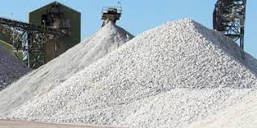
GYPSUM SUPPLIERS

Slide 19
ROCK SALT
The Khewra Salt Mines are among the world's oldest and biggest salt mines
The Himalayan pink salt at khewra mine is the largest and only source of purest pink salt in the world
The Khewra salt mines produce around 325,000 tons of salt per annum
Generally salt has long been used for flavoring and for preserving food
Today, it is widely used in the chemical industry.

Slide 20
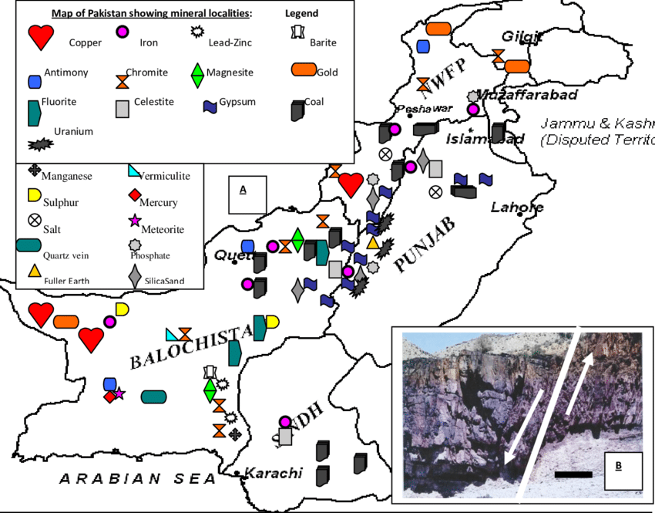

Slide 21
WHY IS THAT ???
The country has the world’s second largest salt mines and fifth largest copper and gold reserves, and second largest coal deposits, as well as estimated billions of barrels of crude oil.
Despite huge potential, contribution of mineral sector to Pakistan’s GDP is around 3 % and country’s exports are only about 0.1% of the world’s total

Slide 22
FEW REASONS:
SECURITY ISSUES(Terrorism)
LACK OF TRAINED LABOR/EXPERTS REGARDING THIS FIELD
LACK OF FINANCES COUPLED WITH INCREASED COST OF EXTRACTION
USE OF CONVENTIONAL MINING TECHNIQUES(causing increased labor deaths)
LACK OF FOREIGN INEVESTMETS
LACK OF GOVERNMENT ATTENTION( low priority so slow development)

